Slide 1
Predicting Energy Star Scores using Seattle 2019 Building Benchmarking Data
Divya Singh

Slide 2
Anthropogenic Emissions: Building a Bleak Future
Scientific justification for the causal link between greenhouse gas (“GHG”) emissions and global warming has increased significantly
The International Energy Agency has reported that when “indirect emissions from upstream power generation are considered, buildings were responsible for 28% of global energy-related CO2 emissions in 2019”

Slide 3
Energy Star Guidance
The first step toward reducing these emissions is establishing a benchmark of how much carbon dioxide buildings currently emit.
The EPA’s Energy Star program allows building managers to collapse the environmental qualities of their buildings into a single metric
Using regression modeling, we can create a predictive model to predict building Energy Star ratings based on existing building information readily available for public access
A model was created using the 2019 Building Benchmarking data available on the Seattle Open Data Portal
This information can be used by real estate developers and building operators to facilitate the transition to a lower emission future while providing cities with additional commercial and residential space

Slide 4
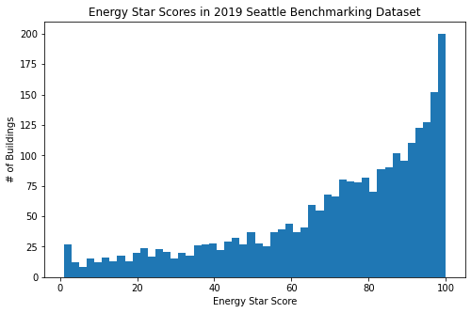
Energy Star Scores in Existing Dataset
The existing dataset contained Energy Star ratings for buildings in Seattle, WA ranging from 0 to 100.
This dataset originally included 3,852 rows, one for each building, and 42 columns populated with building attributes. For the regression model, the dataset was refined to 1,766 rows and 40 columns.
Refinements included:
Removing City, State columns
Removing outlier values (beyond 3 standard deviations from the mean of all numerical columns)
Removing rows with missing Energy Star ratings

Slide 5
Key Building Attributes
Certain attributes chosen for Exploratory Data Analysis include:
PropertyGFATotal - total building and parking gross floor area
SiteEUI - the annual amount of energy consumed by the property from all sources of energy, divided by gross floor area
SourceEUI - the annual amount of energy used to operate the property, including losses from generation, transmission, and distribution, divided by gross floor area
Electricity - the amount of electricity consumed by the property
NaturalGas - the amount of utility-supplied natural gas consumed by the property
TotalGHGEmissions - the total amount of greenhouse gas emissions, including carbon dioxide, methane, and nitrous oxide gases released into the atmosphere as a result of energy consumption at the property

Slide 6
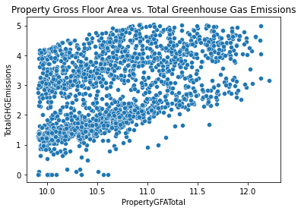
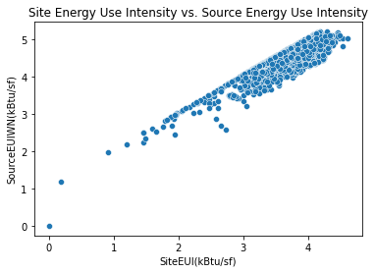
Exploratory Data Analysis

Slide 7
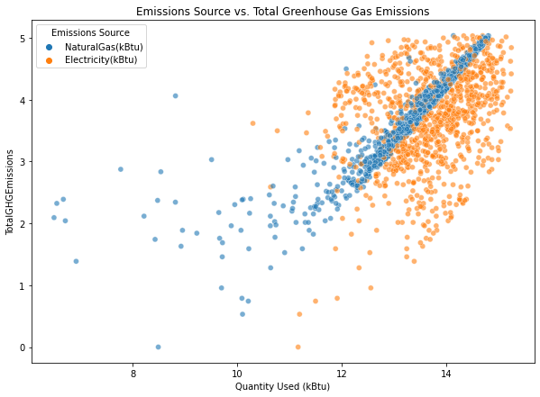
Exploratory Data Analysis (cont’d)
The natural gas distribution seems to have a stronger positive correlation with total greenhouse gas emissions than electricity consumption does. This raises the question of what mix of sources of electricity generation is supplying power to the buildings in the dataset. Lower carbon sources such as renewable power generation could be contributing to this relationship.

Slide 8
Regression Modeling Overview
Two types of regression models were created:
Linear Regression - trying to derive a “y=mx+b” linear relationship between the independent variable(s) and the dependent variable
Random Forest Regressor - ensemble of decision trees, estimating continuous variables using a series of “if/then” conditional statements
This technique was used with and without cross-validation to assess whether results were affected by overfitting
*Prior to performing the regression modeling, feature engineering was performed to facilitate the use of categorical data in modeling. The Neighborhood and Building (indicating building type) columns were the focus of this step

Slide 9
Modeling Parameters
Four scenarios were compared. For each, 67% of the refined dataset was used for training the model, and 33% of the dataset was used as a control group.
Linear Regression
Random Forest - no hyperparameter tuning or cross-validation
Used default scikit learn parameters and hyperparameters
Random Forest - with hyperparameter tuning, no cross-validation
Used RandomizedSearchCV and GridSearchCV to optimize the number of trees, the number of nodes, and the number of features used in the ensemble
Random Forest - with hyperparameter tuning and cross-validation
Same as previous scenario but used cross-validation to cycle to use various chunks of the dataset to “generalize” the model and simulate comparisons against more data

Slide 10
Results
 | Linear Regression | Random Forest - no hyperparameter tuning or cross-validation | Random Forest - hyperparameter tuning, no cross-validation | Random Forest - hyperparameter tuning, with cross-validation
r^2 - Training Set | 0.42 | 0.93 | 0.93 | 0.93
r^2 - Test Set | 0.44 | 0.60 | 0.60 | 0.48
Mean Absolute Error - Training Set | 12.9 | 4.4 | 4.4 | 4.5
Mean Absolute Error - Test Set | 12.4 | 10.0 | 10.0 | 11.9

Slide 11
Takeaways
The results suggested that there was a relatively low “ceiling” of performance, and that further model sophistication did not materially improve results
Energy Star ratings range from 0-100, so a 10 point residual is meaningful
Reducing the number of columns could potentially improve performance as having 57 columns potentially causes certain columns to contain too few rows
Would be interesting to see these results compared against other benchmarking data (either from previous years or from different cities)

